Slide 2






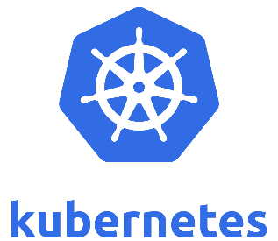
DTA What the Hack?!
AppDev/Infra/Data/AI
FRIDAY September 14th, 2018
8:00am – 1:00pm

Slide 3
DTA What The Hack?! Agenda
8:00am-8:30am – Kick Off
Executive Welcome (5 mins)
A few words from our sponsors…
Partner Session 1 (5 mins)
Partner Session 2 (5 mins)
How all of this will work (10 mins)
8:30am-1:00pm – Get your Hack on!
1:00pm – Head for the airport! (not a minute before!)

Slide 4
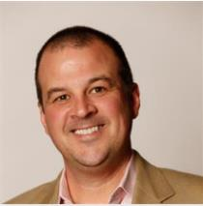

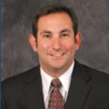
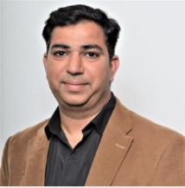
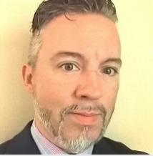
DTA What the Hack?!
Executive Intro
Chris Hallberg
Tony Surma
GM US Customer Success
US OCP Chief Architect
Tom DeFeo
Gaurav Hind
Director – US National CSA
CSA Director – US FSI
Jeff Fattic
CSA Director – US Healthcare

Slide 5
Welcome to DTA What the Hack?!
Why
What
Build Skills to Engage Developers in Your Accounts
Content / Approach to engage Developers / Drive Impact
Have Fun, Meet Others, Build Your Network
4 Hacks in 4 Rooms
Infrastructure Challenges
App Dev Challenges
Data Challenges
Machine Learning and AI Challenges
How
What Next
Teams of 6
Challenge-based Hacks
Use Teams, Collaborate, Hack
Detailed Instructions to Follow!
Go out and win with developers today
Hack with your Customers – leverage approach and content
Leverage Dev Boss in a Box: aka.ms/devbossinabox
Encourage Developers to sign up for the US Developer Newsletter: aka.ms/usintelligentcloudnewslettersubscribe

Slide 6
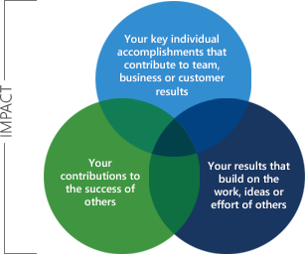
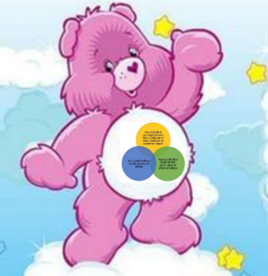
As you hack, remember…
Individual results are important, yet…
Learning from others is IMPORTANTer!
Sharing is caring & is IMPORTANTest!
Notes:
We want our culture to live the new company values.
You probably have seen the “circles of live” or “circles of your connect”
The sharing & learning circles are vital to our success and will drive our culture

Slide 7
You are a key stakeholder in the US Developer Win Formula
Win Formula
Pillar: Tactic | Program | Description | Target Date | Owner | Status*
Awareness: Contact Acquisition | Dev Boss | Acquire developer contacts and help them get swag through this content-packaged offer. https://aka.ms/devbossinabox https://aka.ms/getswag | Q1 | Sales | TBD
 | Dev Newsletter | Have customers subscribe to the customer-facing developer newsletter https://aka.ms/usintelligentcloudnewslettersubscribe | Q1 | Sales | TBD
Engagement: Training & Events | Enterprise Skills Initiative | CSA-led account-specific learning plan funded via ECIF & SATV https://aka.ms/entskill | Q1 | CSA | TBD
 | Azure Day | 1:1 custom event at customer’s site https://aka.ms/usicintake | Q1 | ABM | TBD
 | Azure Discovery & Insight Day | 1:many Discovery Day + 1:1 Insights ½ Day Pilot in Q2 – Driven by US National CSA Team | Q2 | CSA | TBD
 | OpenHack | 1:few event for developers to learn how to implement a given scenario through hands-on, challenge-based hacking https://aka.ms/openhacks | Q1 | CSE | TBD
 | Cloud Immersion Experience (CIE) | 1:few live-online immersion with hands-on cloud platform learning experience https://aka.ms/onlinecloudimmersions | Q1 | Sales | TBD
 | Workshops | 1: few hands-on workshops Bots in a Day: https://aka.ms/biad AI Discovery Days: https://aka.ms/aidd Cloud Workshops: https://aka.ms/uscloudworkshops | Q1 | Sales | TBD
Adoption | Azure Hero Sales Plays | Activate app development advanced workload on Azure https://aka.ms/usdevsalesplays | Q1 | Sales | TBD
 | Developer Support (Premier) | SW Development & Azure Advisor service, providing skillful guidance to optimize & support app dev process https://aka.ms/getdev | Q1 | Sales | TBD
Custom
Non-Custom
Notes:
Owner: Person that has to make sure the action happens
ABM/SSP/AE: Should all be made aware
Example of D0365 Win Formula plan (1 page)
Next slide is example of tracking/reporting of plan

Slide 8
Developer Community Ambassador Program
Who ambassadors are
-MSFT employees with a passion for developer communities
-MSFT employees interested in engaging with developers
What ambassadors do
-Create communities within their customer accounts
-Engage in developer communities
-Demonstrate Azure’s capabilities
-Share learnings & best practices with ambassadors
What ambassadors get
-Packaged content to share with communities
-SWAG to take to communities
-Recognition with management
-Opportunity to represent MSFT at events
-Invitation to ambassador connections
Join the “US Dev Community Ambassadors” (USComAmbassadors) via IDWeb

Slide 9
And now a word from our partners…

Slide 10
Tallan OCP Bots in a Day Offering
Craig Branning
CEO Tallan, Inc.
Tim Walton
Microsoft PTS

Slide 11

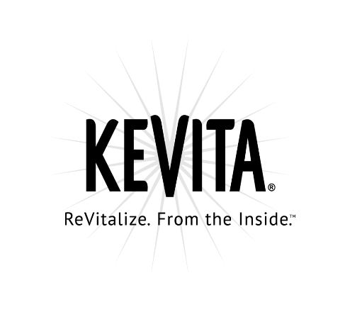







Our Experience
Notes:
Tallan has a vast amount of experience in the Chatbot field in the areas of:
Retail – (Kevita, KIA, Revlon, Coca-Cola)
Customer Service (Western Dental, Harland Clarke)
Government (Egov, State of Delaware)
Finance/Credit (Experian)
These chatbots spanned a wide range of different technologies
We utilized AI and Image Recognition capabilities to scan receipts for purchased items
We used Payment API’s to connect with peoples Paypal and Venmo accounts
We used QnA maker to setup easy FAQs
We used location tracking to find users and show the closest office locations
We used Azure Search to allow for product catalogs
We used LUIS to enable Natural Language capabilities.

Slide 12
The workshop will give attendees insights into a variety of different bots and capabilities such as:
Exploring and learn the various Bots currently available
Experiencing Bots that have been built using the Microsoft Bot Framework and Bot Intelligence
Planning, building, and deploying a Bot experience
Exploring options with less effort using Form Flow capabilities
Advanced scenarios such as back-end system integration, bot intelligence, cognitive services, using LUIS to build your bot, bot commerce and others
What’s Covered?
Bot in a Day Materials - https://goo.gl/Rqof4N
Notes:
Full day event can be done on-site at the customer
Workshop is good for both developers and non-developers
Helps people get a sense of “what is possible” with the Microsoft Bot Framework and why they should use tools from Microsoft over other 3rd party Chatbot and AI tools
Allows customers to build out a fully functioning Customer Service POC bot so they leave with actual working code
Also covers integration with other Cognitive Services like LUIS and Text Analytics

Slide 13


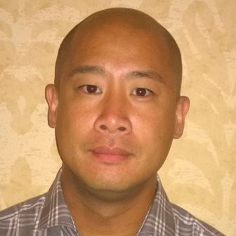
Tallan has been working with Microsoft’s Engineering and Marketing & Operations teams on the next Generation of A.I. development.
The Team
Justin Ross
Depth Partner Marketing Lead, US Cloud & Enterprise
James Byun
1st Artificial Intelligence (AI) Go-to-Market Lead
Steven Meyer
Sales Manager - Azure Mobile Black Belts
Notes:
We have been working with the M&O team and the Engineering team to be lock step in developing this offering as well as providing constant feedback about how we can improve and what new offerings we can create

Slide 14
Partner-Led Azure Customer Experience (PACE)
Offer Summary
Partner Eligibility
The FY19 1:Many Partner-Led Azure Customer Experience (PACE) provides funding and marketing BoM to support 1:Many partner-led, in-person customer events such as executive roundtables and solution roadshows.
All US Silver or Gold Cloud Platform or Data Platform competency partners can participate in this program
Types of Activities Supported
Eligible Customers
Funding Limits
In-person activities, such as:
Executive Roundtables
Solution Roadshows
Hackfests
Bots-in-a-Day
Dashboard-in-a-Day
Microsoft Cloud Workshops (MCW)
Cloud immersion Experiences (CIE)
All US Managed Customers and unmanaged customers
The payout for the program is $1.5K per activity
Next Steps
Request funding and find full offer details: Partner Investment Engine (PIE)
Help and Support: heromaker@microsoft.com
Attend Partner Readiness calls: Register here to attend the weekly office hours on the US Cloud PIE programs and ECIF
Notes:
SIF Funding is available for these events to make it more enticing to the customer
ESIF also available for specific accounts

Slide 15
Bottom Line
Service Type | Description |  | Estimated Cost
Cognitive Services | Text Analytics API |  | $ 500.00
Azure Search |  |  | $ 96.77
Cognitive Services | Translator Text API |  | $ 2,055.00
Cognitive Services | Recommendations API |  | $ 500.00
Storage |  |  | $ 15.58
SQL Database | 2 standard database |  | $ 149.99
Application Insights | Enterprise tier in one region |  | $ 50.00
App Service |  |  | $ 892.80
Support | Support |  | $ 300.00
Power BI | 50 Users |  | $ 499.50
Microsoft CRM + Flow | Dynamics 365 Plan, 50 Users |  | $ 5,750.00
Office 365 | Enterprise 3, 50 * $20.00 |  | $ 1,000.00
QnAMaker Azure Search |  |  | $ 310.00
 |  | Monthly | $ 12,119.64
 |  | Annual | $ 145,435.68
Notes:
This is a breakdown of what type of Azure spend you can expect to see from a fully featured bot.
12k+ a month in potential consumption
Ample opportunity to cross sell into O365, Power BI, CRM leveraging bot technology

Slide 16
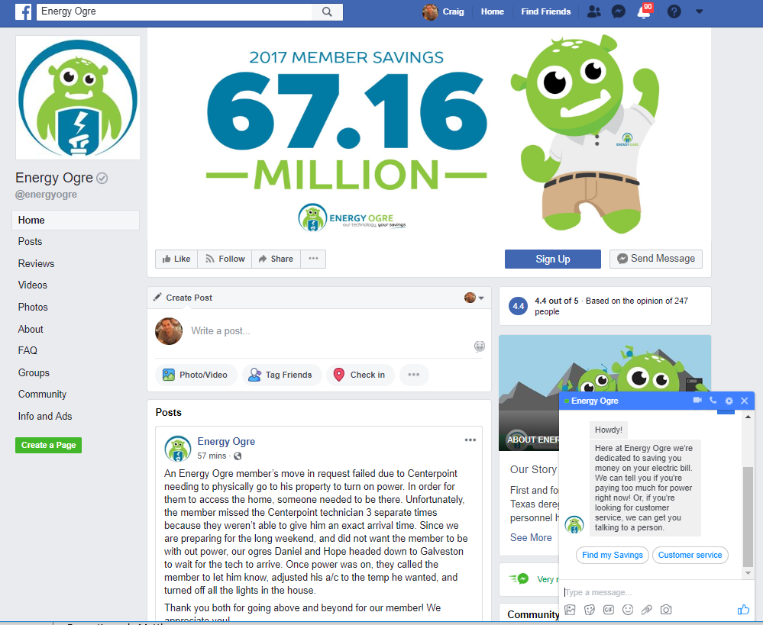
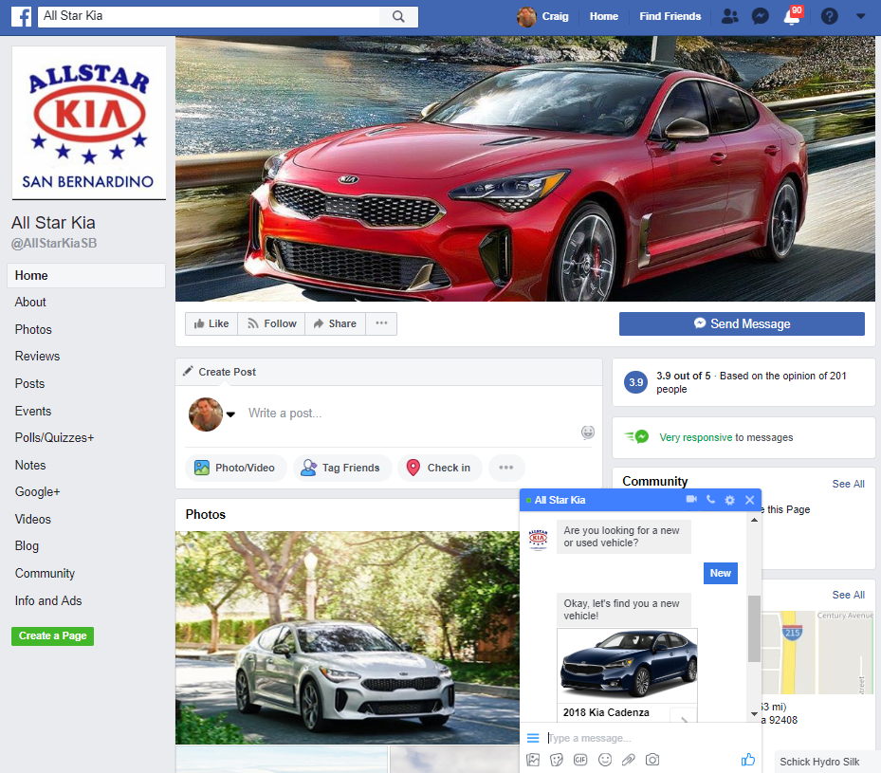
Individual Demo - Valassis
https://www.facebook.com/AllStarKiaSB/
https://www.facebook.com/energyogre/
Notes:
Tim: eGov example
Risk Mitigation and Friction Free
IP Co-Sell Ready Solution that you directly target your customer
Can be fully or partially funded
Drive ACR and ACA

Slide 17
Cognitive Services in a Day Agenda
9:30 – 10:00 Welcome and Introductions
Pilot Workshops
10:00 – 10:45 | Introduction to Cognitive Services
10:45 – 11:00 | Break
11:00 – 12:00 | Bing Visual Search
12:00 – 12:30 | Lunch
12:30 – 1:30 | Bing Custom Search
1:30 – 2:30 | Text Analytics
2:30 – 2:45 | Break
2:45 – 3:45 | Content Moderator
3:45 – 4:45 | Wrap-up & Q&A
Notes:
We are working with Microsoft to provide even more workshops such as Cognitive Services in A Day
Piloting in December of 2018 in the NYC area
Touches upon a lot of the different higher profile Cog Services like
Bing Search
Content Moderator
Text Analytics
Again teaches the “art of the possible”

Slide 18
Machine Learning in a Day Agenda
9:30 – 10:00 Welcome and Introductions
Pilot Workshops
10:00 – 10:45 | Machine Learning History
10:45 – 11:00 | Industry Examples
11:00 – 12:00 | Azure Machine Learning Studio
12:00 – 12:30 | Lunch
12:30 – 1:30 | Machine Learning Life Cycle
1:30 – 2:30 | ML at Enterprise Scale
2:30 – 2:45 | Break
2:45 – 3:45 | Hands-on ML
3:45 – 4:45 | Wrap-up & Q&A
Notes:
Meant to help simplify ML so that it’s more approachable.
How people can get started with ML on a small scale to prove value

Slide 19
https://www.tallan.com/company/events/
UPCOMING EVENTS:
Bot in a Day with Microsoft
Hands-on workshop that focuses on the basics of bots, their AI technologies, potential use cases, and how they are built.
Where: Dallas, TX When: September 25, 2018 at 9:00 a.m.
Bot in a Day with Microsoft
Hands-on workshop that focuses on the basics of bots, their AI technologies, potential use cases, and how they are built.
Where: New York, NY When: September 26, 2018 at 9:00 a.m.
Tallan Upcoming Events
Notes:
Current BOT in a Day workshops being hosted by Microsoft that are completely free for clients
These are given on a continuous basis by Tallan at various Microsoft Technology Centers and are a good way to get companies in the door

Slide 20
Thank You!

Slide 21
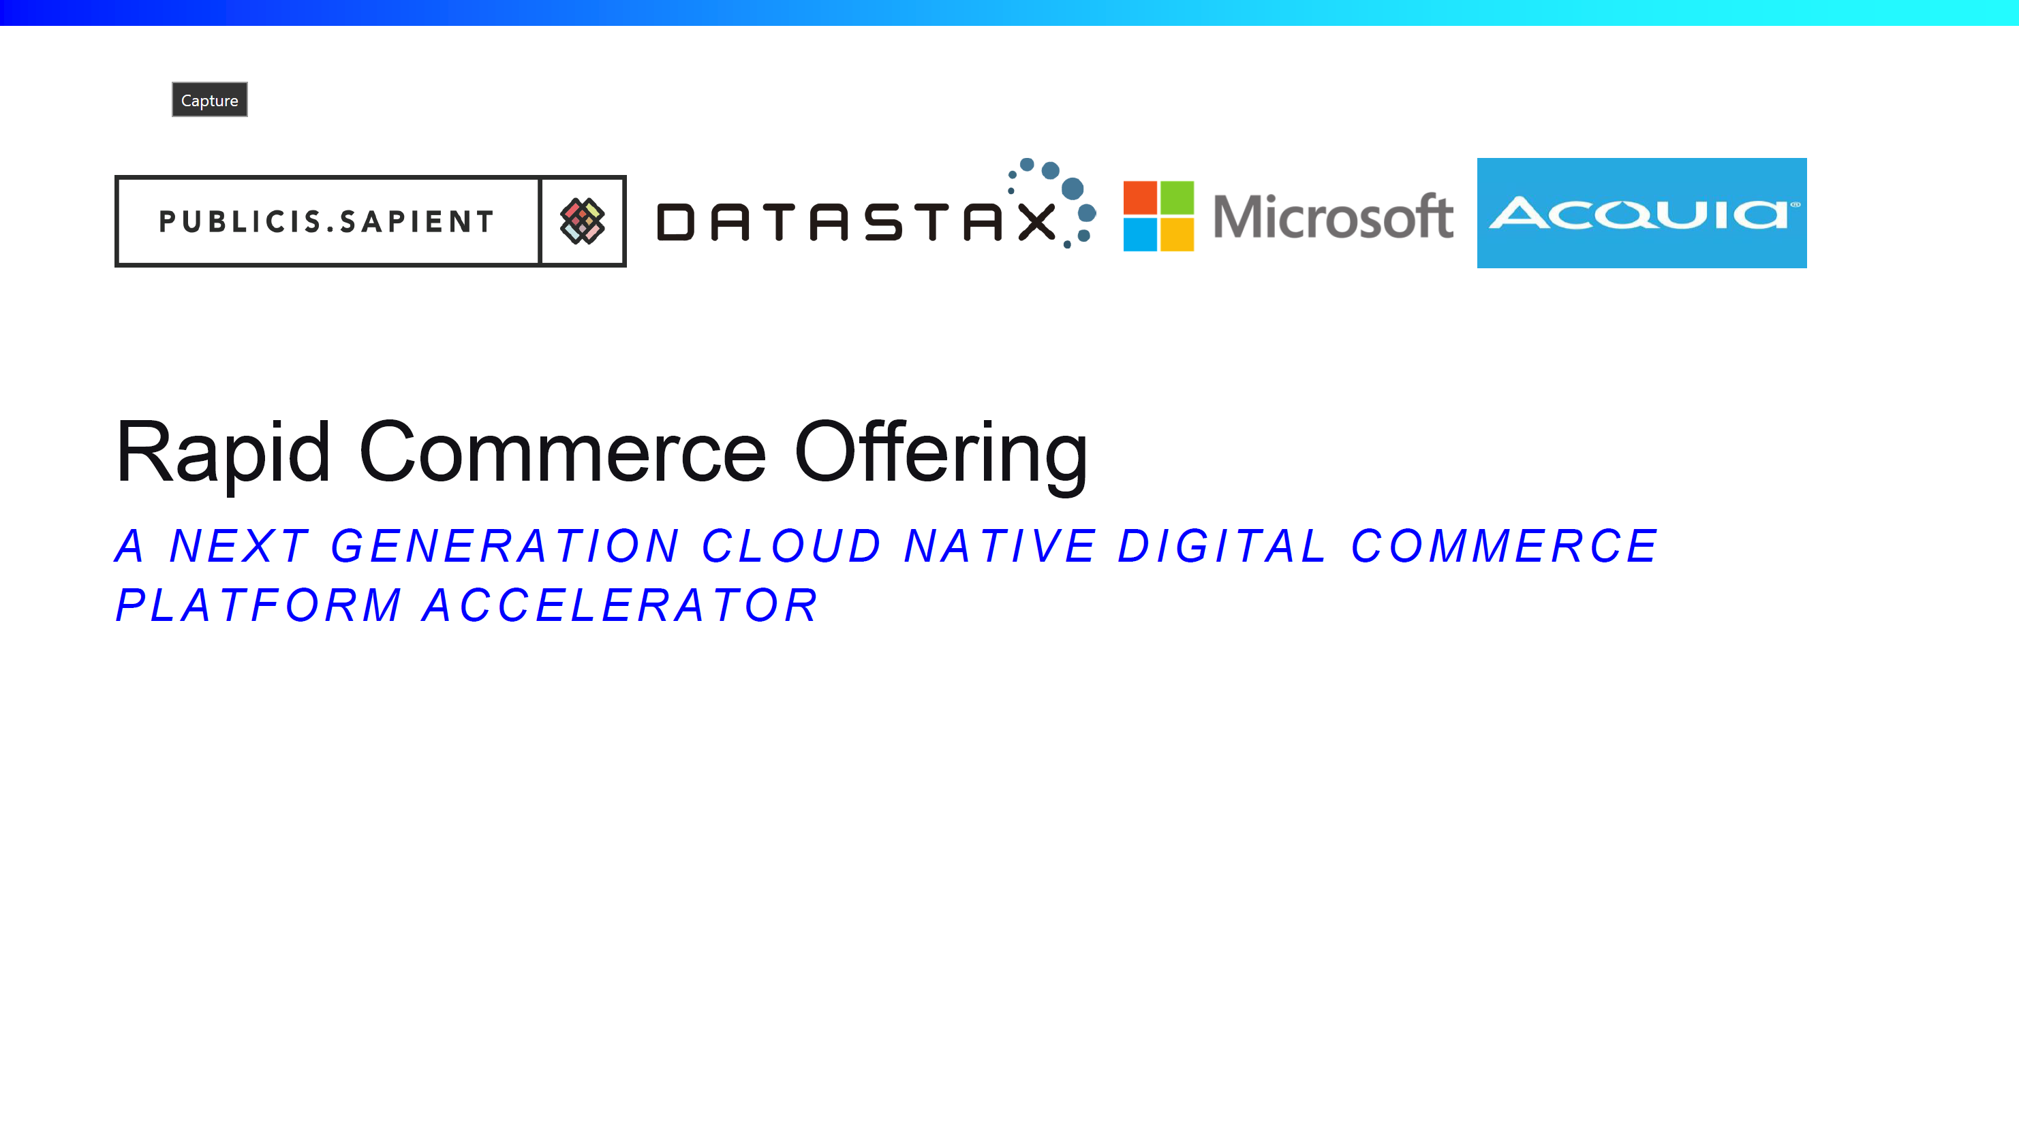

Slide 22
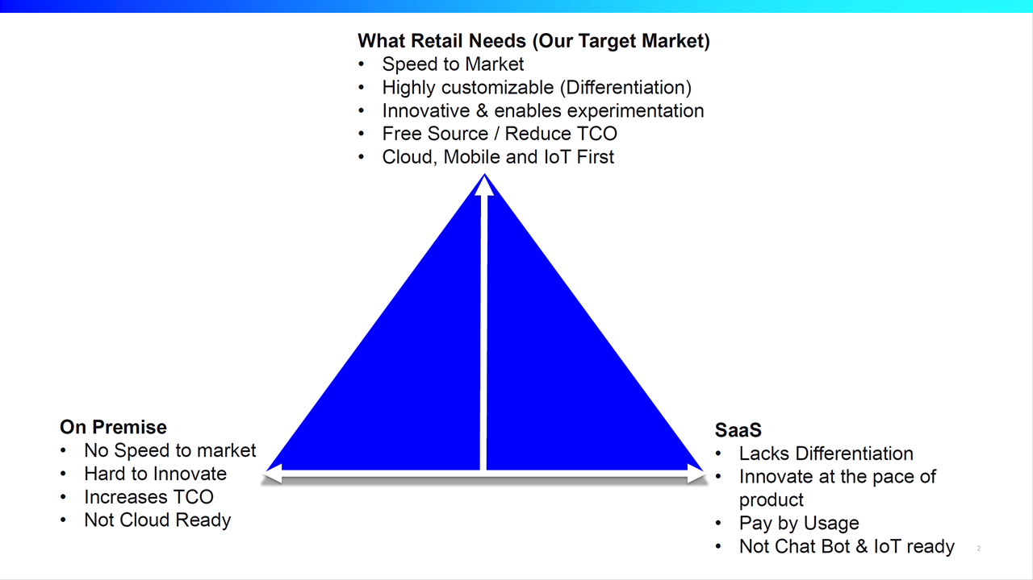

Slide 23
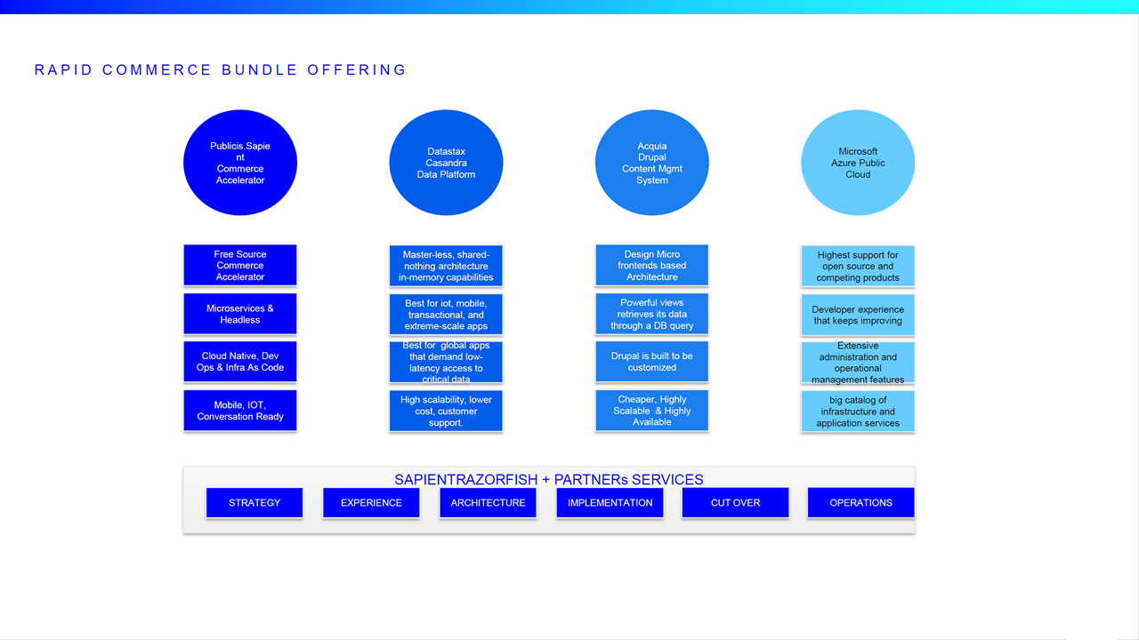

Slide 24
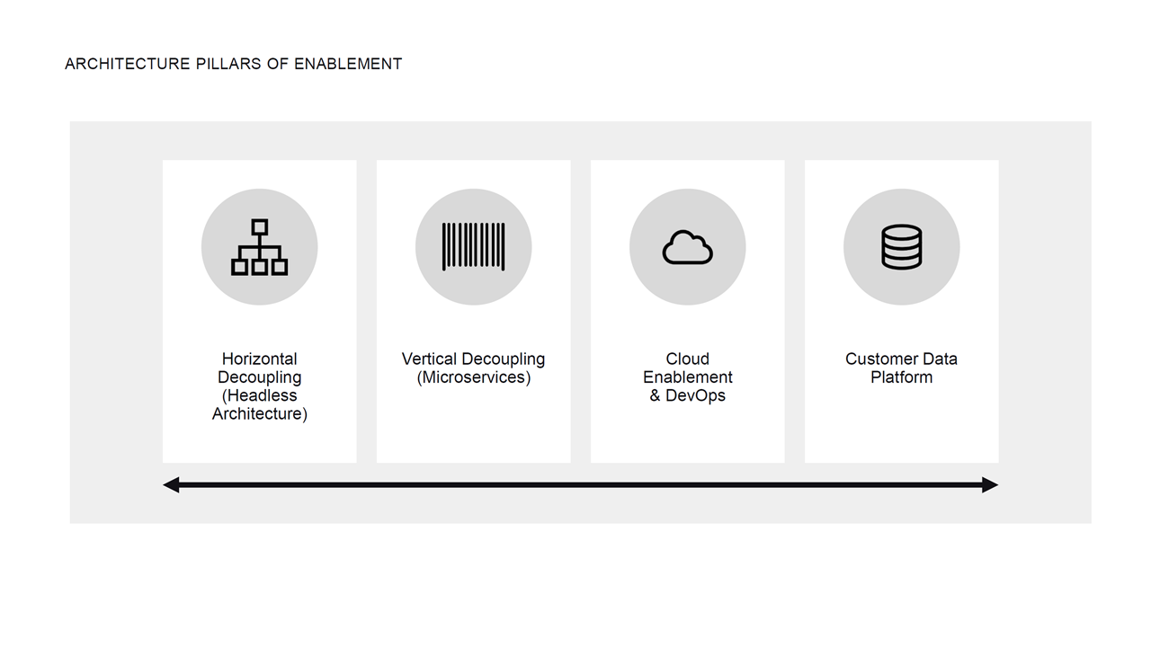

Slide 25
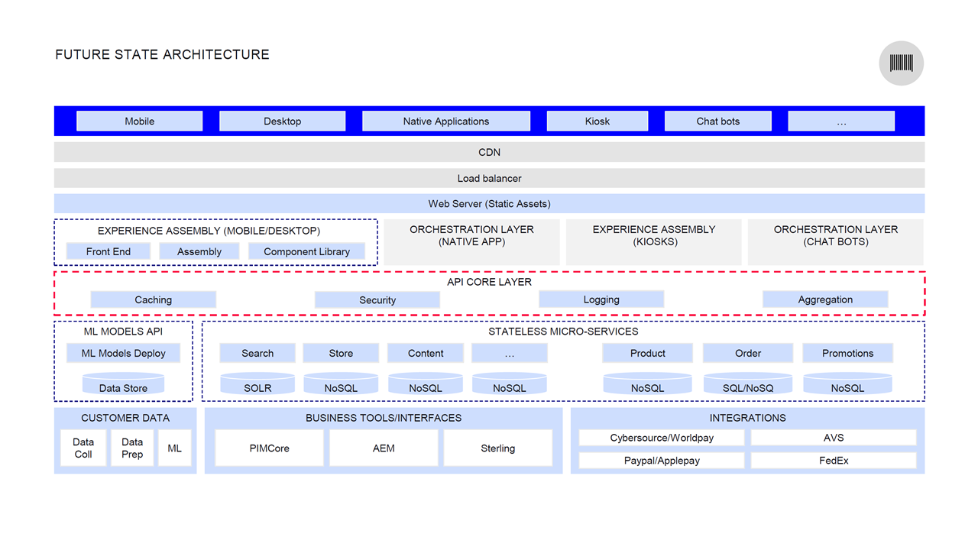

Slide 26
Artificial Intelligence Kick-off
DTA What The Hack?!
September 2018

Slide 27

DTA What the Hack?!
Welcome & Intros
Gino Filicetti
Patrick El-Azem
CSA – National CSA Team
CSA – National CSA Team
Data
Infrastructure
Peter Laudati
Neelam Gupta
CSA – US OCP Team
CSA – National CSA Team
Laura Edell
Kamran Bhurgri
CSA – National CSA Team
Architect – US MTC
AI
App Dev
Diana Phillips
Rich Ross
CSA – US OCP Team
Architect – US MTC

Slide 28
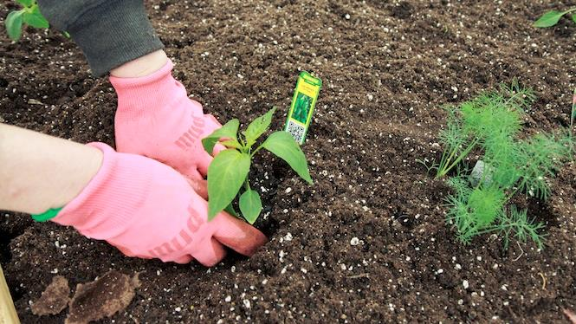
You will get your hands dirty
Notes:
You only get out what you put in, don't be lazy.
Knowledge Retention through Pain and Discomfort

Slide 29
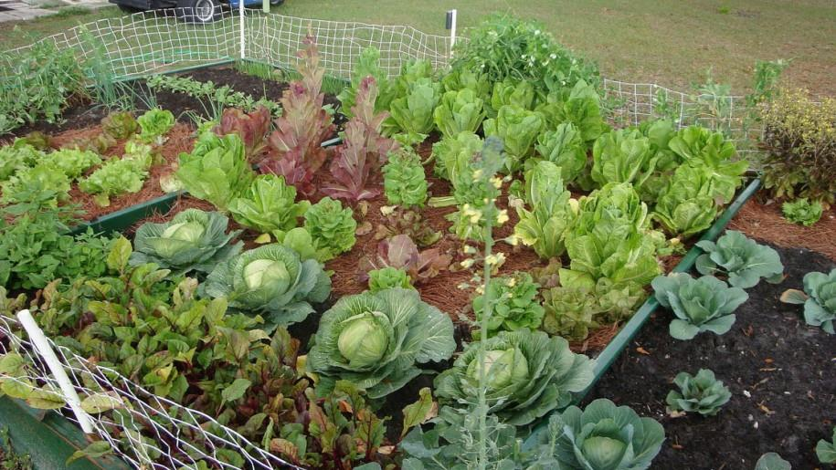
*results may vary
Notes:
You might not grow a garden like this… but at least you can learn while trying.

Slide 30

Logistics
Notes:
And now we’ll cover logistics…

Slide 31
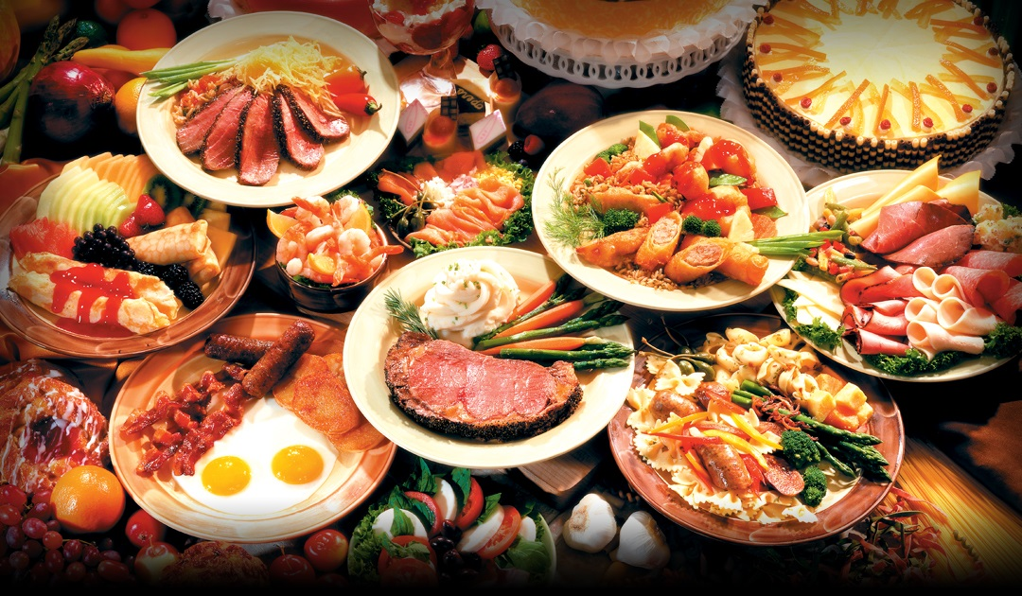
Logistics Food
Notes:
Plenty of food… all of the time…
Food should be served in the hallway outside these rooms. Take breaks as you need them.

Slide 32
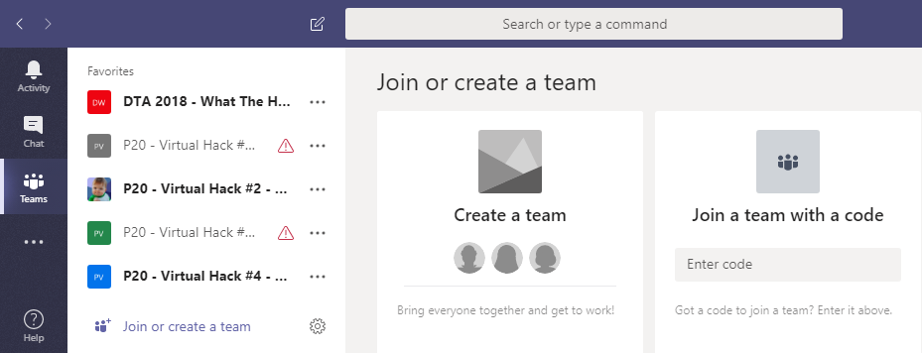
Collaboration
Step 1: Join the Team!
Team: “DTA 2018 - What The Hack - AI”
Join Code: “jil8vbw”
#2
#1
jil8vbw

Slide 33
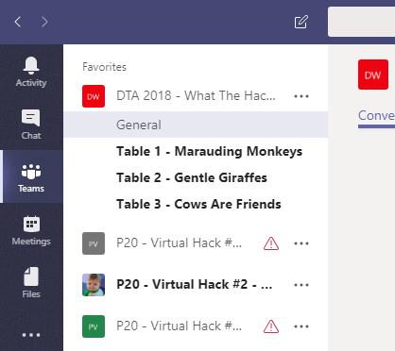
Collaboration
Step 2: Create a Channel for your table’s team!
Name your team something unique and fun, but prefix with your table #!
Team: “DTA 2018 - What The Hack - AI”
Join Code: “jil8vbw”

Slide 34
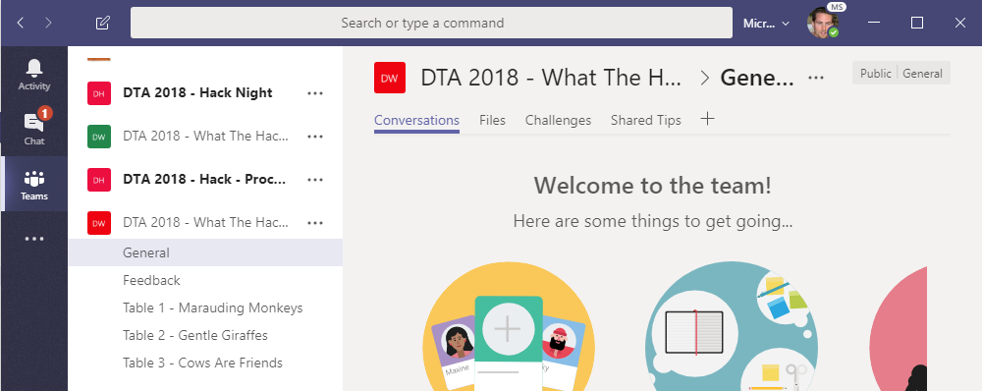
Collaboration
Step 3: Collaborate!
Hang out, communicate, talk, and screenshare with squad members in your squad’s channel
DURING & after the event, share feedback with the proctors in the Feedback channel. This will help them improve the event as it progresses and make the next one even better
Find any files, resources, or code samples, and THIS presentation here!
Challenges will be posted here by the proctors throughout the event
Share tips, tricks, gotchas (how you solved them), code snippets, and links you learn along the way here with everyone

Slide 35
Format
Challenges are generally cumulative, building upon each other
Establish Confidence – start small and simple (think hello world)
Build Competence – by having successively more complex challenges
Challenges are NOT step-by-step hands on labs!
No “clicking here” or “copy n pasting there”
Challenge definitions are short. A couple of sentences or bullet points stating the end goal(s) and perhaps a hint at the skill(s) needed.
You MUST work together as a team to figure out how to complete them!

Slide 36
Format
For each challenge we will deliver a ”mini-lecture” explaining concepts in it.
We’ll review results for each challenge when it looks like a majority of folks have completed the challenge
Don’t be beholden by the clock!
Move quickly or take it slow.
Your proctors are here to help you.
There WILL be more challenges than you can complete in 5 hours!
These are takeaways for follow up at home or with customers!

Slide 37
Proctors
Each team will have a proctor through-out the whole hack.
Use them! But don’t expect them to give you all the answers.
Get to know your proctor, their likes and dislikes...
All the better to find a bribe that works!
Notes:
Keep the teams working as teams!
Encourage all to “learn from” and “share with” each other!
If you observe individuals racing ahead, encourage them to help those who are behind.
Encourage attendees to use their team’s channel on MS Teams to collaborate/share info!
Unblock teams who get stuck
Encourage team members to unblock each other first!
Provide hints, but not answers
If you observe individuals stuck for a while, help them get moving so they don’t lose interest.
Provide hints/pointers to the teams on how to solve problems & where to find information.
Use the answers/solutions in the proctor’s guide, but don’t share with the attendees
Proctor’s guide won’t be comprehensive. As SMEs, proctors should use their knowledge to help with solution hints/ideas.
Notify the emcee of unexpected blockers that arise during the event so they can be communicated to all, and recorded for future reference.

Slide 38
Proctors - AI
Vandy Rodrigues
Amit Agrawal
Jeff Barnes
Jeremy Peach
Sanjeev Devarapalli
Will Johnson
Ryan Lowdermilk
Sriram Ganapathy
GinSiu Cheng
Allan DaCosta Pinto
Abha R Panchal
Cheryl Fichter
Notes:
Keep the teams working as teams!
Encourage all to “learn from” and “share with” each other!
If you observe individuals racing ahead, encourage them to help those who are behind.
Encourage attendees to use their team’s channel on MS Teams to collaborate/share info!
Unblock teams who get stuck
Encourage team members to unblock each other first!
Provide hints, but not answers
If you observe individuals stuck for a while, help them get moving so they don’t lose interest.
Provide hints/pointers to the teams on how to solve problems & where to find information.
Use the answers/solutions in the proctor’s guide, but don’t share with the attendees
Proctor’s guide won’t be comprehensive. As SMEs, proctors should use their knowledge to help with solution hints/ideas.
Notify the emcee of unexpected blockers that arise during the event so they can be communicated to all, and recorded for future reference.

Slide 39
Finding Answers
Search engines are your friend! Plus, we’ve included several key links in the AI Challenges document to get you started.

Slide 40



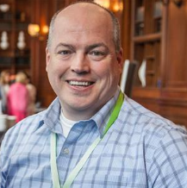

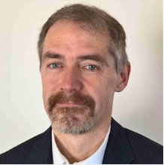
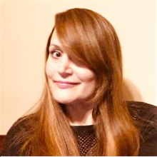



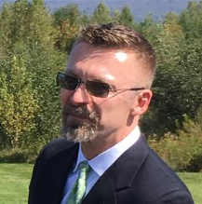
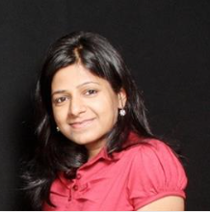
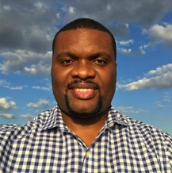
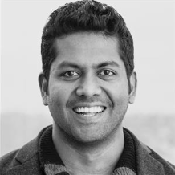





Thank you !!!
Chief Wranglers:
Gino Filicetti and Peter Laudati
DTA What the Hack Contributors:
Kamran Bhurgri, Rich Ross, Ryan Berry, Dave McKinstry
Laura Edell, Diana Phillips,
LT Sponsors:
Chris Hallberg & Tony Surma
Patrick El-Azem, Neelam Gupta
Israel Ekpo, Sowmyan Chullikkattil, Peter Laudati, Gino Filicetti
Todd Van Nurden, Gaurav Hind, Jeff Fattic, Jeff Lear

Slide 41

And now death by Power Point…

Slide 42
And now death by Power Point… (just kidding!)

Slide 43
Artificial Intelligence
deep learning
machine learning
neural networks
search
probabilistic reasoning
etc.
vision
speech
language
knowledge
problem solving
etc.
A set of technologies that enable machine intelligence to simulate or augment elements of human thinking
Notes:
Thought I’d kick off with a quick introduction to k
Artificial intelligence is a set of technologies that enable ‘machine intelligence’ to simulate or augment elements of human thinking. For example, those technologies on the left, such as machine learning and neural networks. And those elements of human thinking on the right, such as vision, speech, and language.
There is a very subtle, but important, aspect in this definition. We are not advocating that machine intelligence should ‘replace’ human intelligence. But, machine intelligence can be used effectively to ‘augment’ or improve the human experience, accomplished via a set of more specialized use cases that map to individual elements of human thinking.
That, is where we think, that at least today, is the greatest opportunity for you as well.

Slide 44
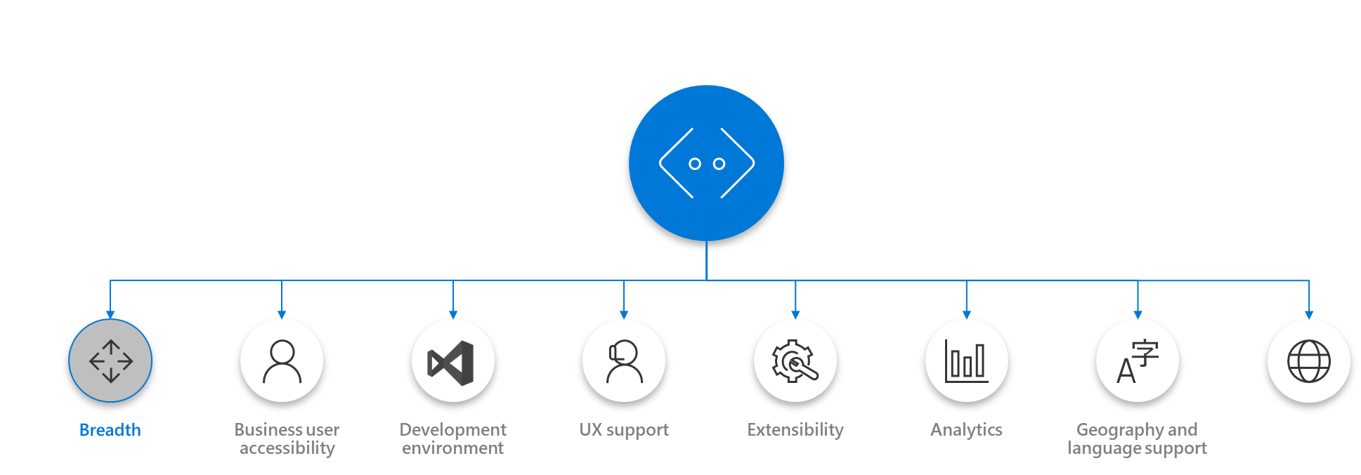
Microsoft AI Platform: Azure + AI
AI SERVICES
AI TOOLS
CONVERSATIONAL AI
AI MODULES
DEVICES
Azure Bot Service
Cognitive Services
Azure IoT Edge
CODING & MANAGEMENT TOOLS
VS Tools for Machine Learning
Azure ML Studio
Azure ML Workbench
AI INFRASTRUCTURE
Others (Pycharm, Jupyter notebooks…)
AI ON DATA
AI COMPUTE
DEEP LEARNING FRAMEWORKS
Cosmos DB
SQL
DB
SQL
DW
Data Lake
Spark
DSVM
Batch AI
ACS
Edge
Cognitive Toolkit
TensorFlow
Caffe
CPU, GPU, FPGA
Others (Scikit-learn, MXNet, Keras, Gluon…)
Notes:
Acronyms
ACS: Applied Computer Solutions
CPU: Central Processing Unit
DB: Database
DSVM: Data Science Virtual Machine
DW: Data Warehouse
FPGA: field-programmable gate array
GPU: Graphics Processing Unit
IOT: Internet of Things
ML: Machine Learning
VS: Visual Studio

Slide 45


MICROSOFT’S Conversational Computing Platforms
BOTS ARE GATEWAYS TO AI SERVICES
Breadth
Business user accessibility
Development environment
UX support
Extensibility
Analytics
Geography and language support
Compliance
Notes:
Notes about Cognitive Services (CS) evolution
Linguistic Analysis is currently in Free preview out of Azure. As we streamline our efforts on the features and services our customers value most, the Microsoft Cognitive Services Linguistic Analysis API will end on May 2018 (date to be confirmed), and we recommend using the Text capabilities of Azure Machine Learning going forward.
Web Language Model is currently in Paid preview on Azure. As we streamline our efforts on the features and services our customers value most, the Microsoft Cognitive Services Web Language Model will end on May 2018 (date to be confirmed), and we recommend using the Text capabilities of Azure Machine Learning going forward.
Emotion is in Paid preview on Azure. As Face API now integrates Emotion recognition, we’ll deprecate Emotion API for May 2018 (date to be confirmed), and we’ll recommend using Face API going forward.
Entity Linking is a service in Free preview out of Azure – in order to be consistent with Azure standards, we’re surfacing this service in the Cognitive Services Labs site. Going further, users will be able to try Entity Linking through the Cognitive Services labs portal.
Knowledge Exploration is a service in Free preview out of Azure – in order to be consistent with Azure standards, we’re surfacing this service in the Cognitive Services Labs site.
Academic Knowledge is a service in Paid preview on Azure. We’re surfacing now this service in the Cognitive Services Labs site.

Slide 46
Conversational AI tools
Language Understanding Intelligent Service
Azure Search
QnA Maker
Teach your apps to understand commands from your users
Integrate search into a conversational experience
Distill information into conversational, easy-to-navigate answers
Bing Speech API
Speaker Recognition API
Translator
Custom Speech Service
Convert speech to text and back again, and understand its intent
Give your app the ability to know who's talking
Easily perform speech and text translation
Fine-tune speech recognition for anyone, anywhere
Notes:
Speech APIs provide state-of-the-art algorithms to process spoken language powered by Bing. This also includes speech synthesis for a subset of languages supported by speech recognition. With these application programming interfaces (APIs) developers can easily include the ability to add speech driven actions into their applications. In certain cases, the APIs allow for real-time interaction with the user as well. Additional capabilities include voice recognition and speaker identification as well as providing partial transcription, meaning that for supported languages the developer can get partial results before the user has finished speaking.
Bing Speech API: Convert audio to text, understand intent, and convert text back to speech for natural responsiveness. Converts spoken audio to text. Synthesize Speech - Synthesize audio from Text.
Custom Speech Service: Custom Speech Service (CRIS) enables you to create customized language models and acoustic models tailored to your application and your users. By uploading speech and/or text data to CRIS that reflects your application and your users, you can create custom models that can be used in conjunction with Microsoft’s existing state-of-the-art speech models. To customize the acoustic model to a particular domain, a collection of speech data is required. This collection consists of a set of audio files of speech data, and a text file of transcriptions of each audio file. The audio data should be representative of the scenario in which you would like to use the recognizer. If you were building an app to search Microsoft Developer Network by voice, it’s likely that terms like “object-oriented” or “namespace” or “dot net” will appear more frequently than in typical voice applications. Customizing the language model will enable the system to learn this. CRIS uses acoustic or language model adaptation to enable the speech recognizer to learn the characteristics of the customer’s data while still getting the benefits of all the data and expertise that went into creating the base models that power the Speech API.
For acoustic model adaptation, the technology is described in this paper: http://research.microsoft.com/pubs/194346/0007893.pdf
Works well when the data is uploaded to CRIS is truly representative of the user population and the expected usage of the application. For language model adaptation, it works best when the data uploaded reflects what people would actually say. Uploading simply a list of new terms is better than nothing but will not be as effective. For acoustic model adaptation, if you want to adapt to elderly speech, you need to upload the speech from many different elderly users, not just one or two. If you upload just one person’s voice, CRIS will learn to do a great job on that voice but will not necessarily learn to generalize to other elderly voices. Similarly, if you want to adapt to a new environment, like a factory, you should upload speech data from many speakers in the factory, not just one.
Speaker Recognition API: Microsoft's state-of-the-art cloud-based speaker recognition algorithms can recognize a human's voice in audio streams. It comprises of two components: speaker verification and speaker identification. Speaker Verification can automatically verify and authenticate users from their voice or speech. It is tightly related to authentication scenarios and is often associated with a pass phrase. Hence, we opt for text-dependent approach, which means speakers need to choose a specific pass phrase to use during both enrollment and verification phases. Speaker Identification can automatically identify the person speaking in an audio file given a group of prospective speakers. The input audio is paired against the provided group of speakers, and in case there is a match found, the speaker’s identity is returned. It is text-independent, which means that there are no restrictions on what the speaker says during the enrollment and recognition phases. A use case is biometric authentication using voice.

Slide 47
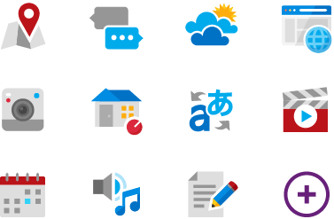

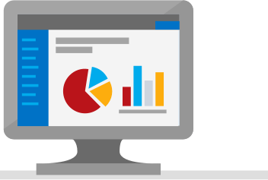
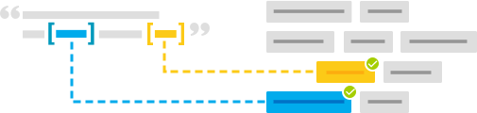
Language Understanding (LUIS)
Machine learning-based service to build natural language into apps, bots, and IoT devices. Quickly create enterprise-ready, custom models that continuously improve
Add natural language to your apps
Quickly build a custom language solution
Always learning and improving
Enterprise-ready, available worldwide
Designed to identify valuable information in conversations, LUIS interprets user goals (intents) and distills valuable information from sentences (entities), for a high quality, nuanced language model.
Custom Models can be created based on the same technology in Azure Machine Learning.
Leverages customizable pre-built apps and entity dictionaries, (e.g., Calendar, Music, Devices).
Dictionaries are mined from the collective knowledge of the web and supply billions of entries, helping your model to correctly identify valuable information from user conversations.
LUIS integrates seamlessly with the Azure Bot Service, making it easy to create a sophisticated bot.
Active learning is used to continuously improve the quality of the natural language models.
Once the model starts processing input, LUIS begins active learning, allowing you to constantly update and improve the model.
The service is ready to be deployed in commercial applications and can scale with enterprise quality and performance.
The service meets international compliance standards, supports 13 languages and available worldwide, making it highly accessible around the world.

Slide 48
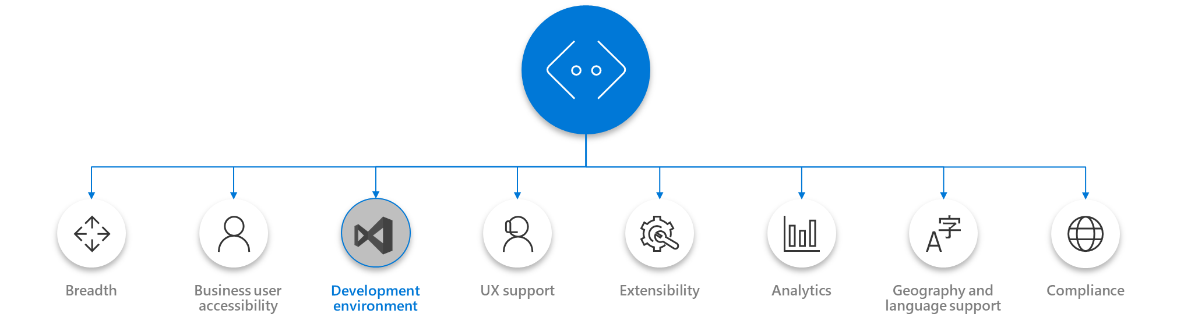
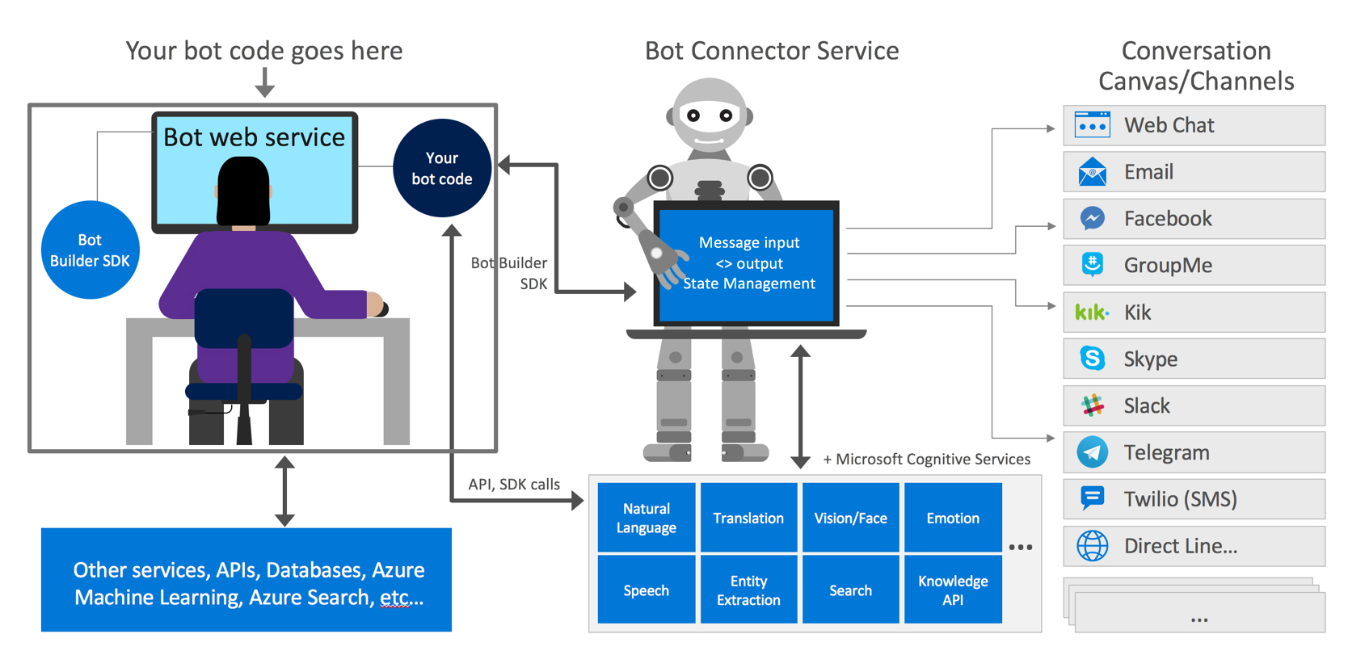
Microsoft Bot Framework
Development Environment
Notes:
https://docs.microsoft.com/en-us/bot-framework/overview-how-bot-framework-works

Slide 49


Microsoft Cognitive Services
Give your apps a human side
Vision
Speech
Language
Knowledge
Search
Computer Vision
Content Moderator
Emotion
Face
Video Indexer
Speech Service
Bing Speech
Speaker Recognition
Translator Speech
Bing Spell Check
Linguistic Analysis
Text Analytics
Translator Text & Speech
Web Language Model
Academic Knowledge
Entity Linking
Knowledge Exploration
QnA Maker
Bing Autosuggest
Bing Image Search
Bing News Search
Bing Video Search
Bing Web Search
Bing Entity Search
CUSTOMIZATION
CUSTOMIZATION
Custom Vision Service
Custom Speech Service
Language Understanding
Custom Decision Service
Bing Custom Search
Notes:
Roughly 30 services and growing
Collection of Intelligent APIs built through Years of research
No Infrastructure requirements
Target any type of application
Pre-built, but also 5 custom services
Today we will fous on the first one – vision.

Slide 50


What Computer Vision Can Do
Image Classification
Is there a deer in the image?
Image segmentation
Where exactly is the deer?
Image Similarity
Which images are similar to the query image?
Object detection
Where in the image is the deer?
Yes
Query image
Similar image
Notes:
For today, I thought we’d focus on computer vision – this is what was used in the Liebherr example.

Slide 51
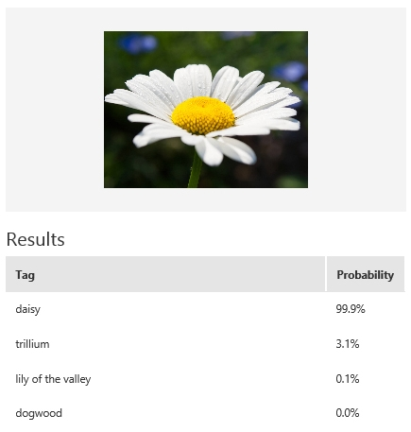
Custom Vision Service
Customizable web service that learns to recognize specific content in imagery
Upload Images
Upload your own labeled images, or use Custom Vision Service to tag any unlabeled images
Train
Use your labeled images to teach Custom Vision Service the concepts you want it to learn
Evaluate
Tag new images with your custom computer vision model and evaluate how well they are identified
Active learning
Images evaluated through your custom vision model become part of a feedback loop you can use to keep improving your classifier
Notes:
Custom Vision Service allows you to add your own images so you can go above and beyond the computer vision service.
Basics
Upload, Train, Evaluate, Active Learning
Example -> Flowers
Classifier only needs 30 images to start quick prototype

Slide 52





Custom Vision – IoT Edge Deployment
Custom Vision Docker Container
Processing Code Docker Container
Custom Vision Docker Container
Azure Container Registry
Processing Code Docker Container
Deployment Manifest
Deployment Manifest
IoT Edge Device
Azure IoT Hub
Custom Vision
Custom Code
Notes:
How to use them
Web API example
Any Platform, Any Language
Easy integration
MSFT products

Slide 53




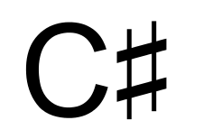









How you can use Cognitive Services
AI-as-a-service
REST-based APIs in the cloud
Deploy as Docker Container to Edge (Vision)
Integrate into the language and platform of your choice
Bring your own data for a custom experience
Tap into an ever-growing collection of AI algorithms developed by experts in their field from Microsoft Research, Bing, and Azure Machine Learning
These capabilities are used across many Microsoft first party products such as Cortana, Bing and Skype
GET A KEY
BUILD
Ruby
Notes:
How to use them
Web API example
Edge example
Any Platform, Any Language
Easy integration
MSFT products

Slide 54
So many use cases!
Anomaly Detection
Fraud Detection
Yield Analysis
Root Cause Analysis
Predictive Maintenance
Video Surveillance
Crowd Management
Traffic Detection
Customer Satisfaction
Compliance
Precision Agriculture
Notes:
Predictive Maintenance
Default Detection
Fraud Detection (energy meters)
Video Surveillance
Connected Events
Crowd Movement (cell phones at Changi, Sports Arenas)
Intelligent Kiosk (?)
SmartSpaces
Customer Satisfaction (manage your own energy consumption relative to neighborhood)
Organizing/Tagging Data (e.g. what data needs to be saved for compliance)
Precision Agriculture (soil, insects, moisture measurements to determine how much fertilizer to apply)

Slide 55
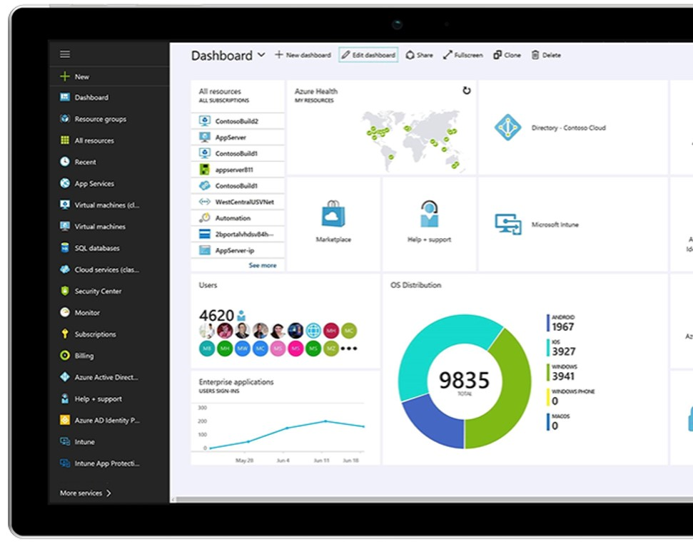
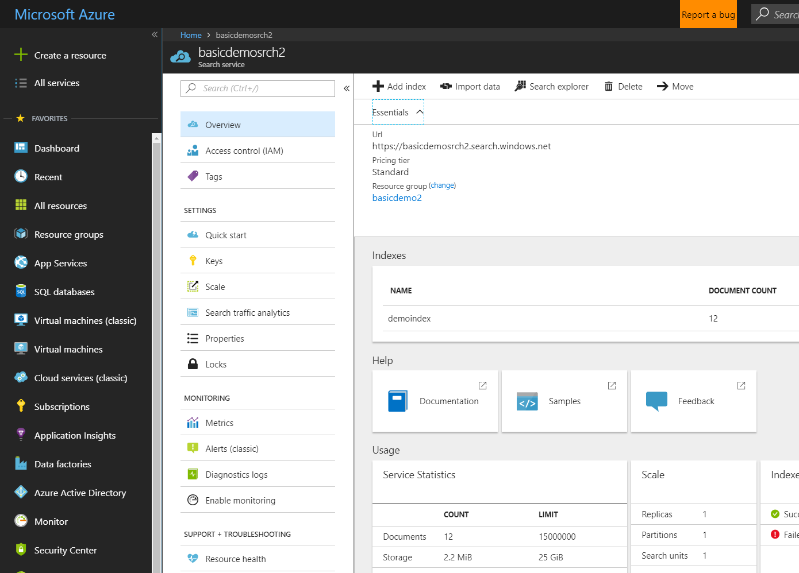

Azure Search Search-as-a-Service Management Free Keyword search Faceting Geospatial support Multi-Language Support Suggestions/auto-complete Customizable scoring models Proximity Search Synonyms etc.
Azure Search

Slide 56
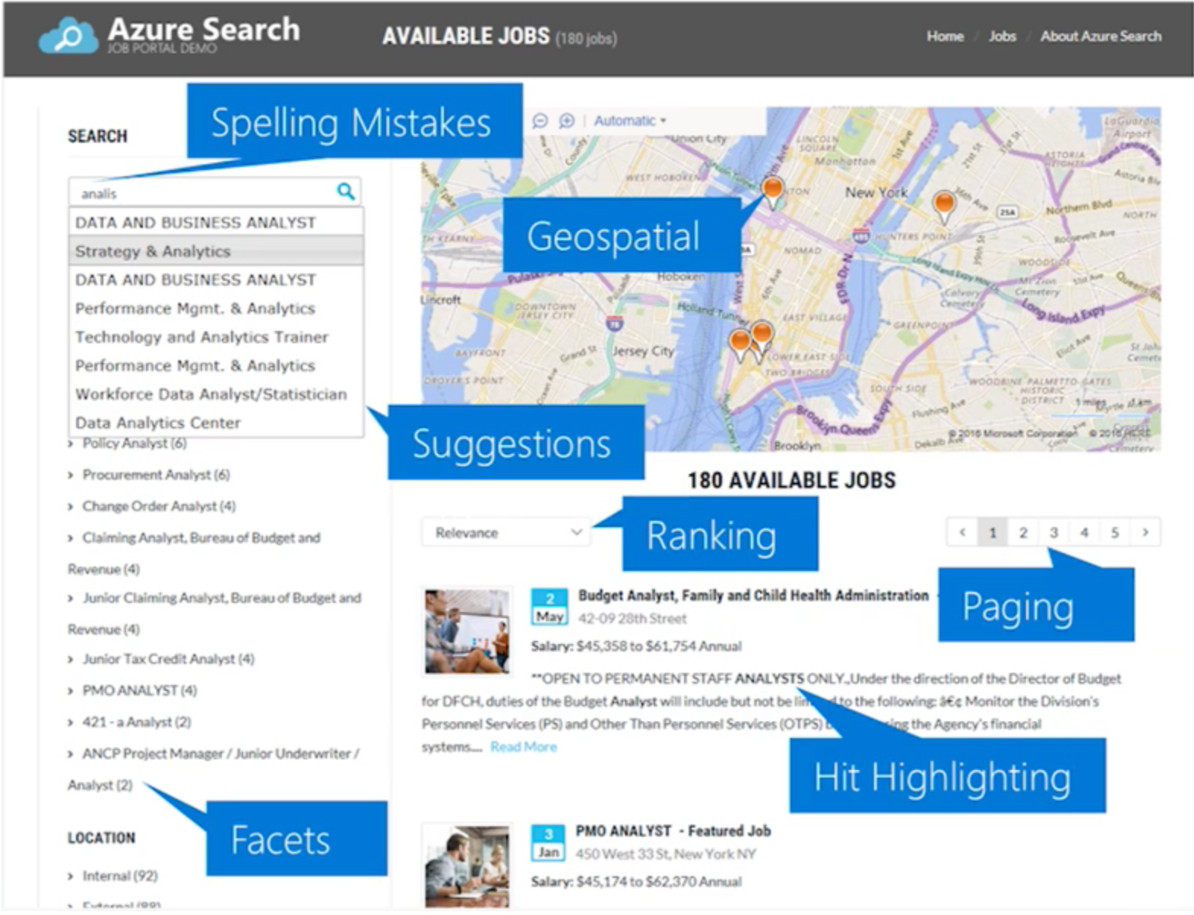

Slide 57
Cognitive Search
AN AI–FIRST APPROACH TO CONTENT UNDERSTANDING
Ingest
Enrich
Explore
Data
Cognitive Skills
Azure Search

Slide 58



Cognitive Search Architecture
IEnricher
IEnricher
Cognitive Skill
Document Cracking
Skillset:
Extensible enrichment
pipeline
Indexing for Search
Customer Data
Annotated Documents
Search Index
.pdf
.doc
.jpeg
…
Built-in Cognitive Skills OCR, Key Phrase Extraction, People Names, Company Names,
Sentiment Analyzer, Computer Vision,
etc.
Third Party Enrichers Custom classification models, Custom entity extraction,
etc.
Azure Machine Learning

Slide 59
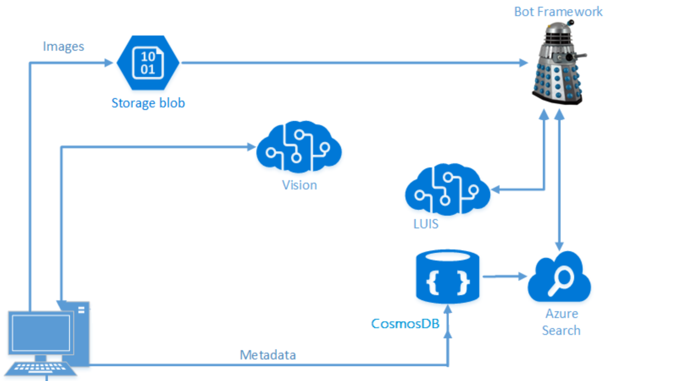
Ready to Start Hacking?
Your challenges are broken into two parts:
Cognitive Services
Bots

Slide 60
Part 1: Cognitive Services
Challenges
1.1: Create a Cognitive Services App using Portable Class Libraries
1.2: Create an Image Classification Application using the Custom Vision Service – Trees
1.3: Create an Image Classification Application using the Custom Vision Service – Vehicle Damage
1.4: Create an Image Classification Application using the Custom Vision Service – Bikes
1.5: Develop Intelligent Applications with Language Understanding (LUIS)

Slide 61
Part 2: Bots
Challenges:
2.1: Developing Intelligent Applications with Azure Search
2.2: Building Intelligent Bots
2.3: Log Chat Conversations in your Bot
2.4: Testing your Bot

